Slide 1


Slide 2
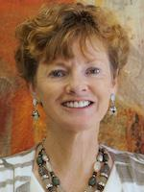
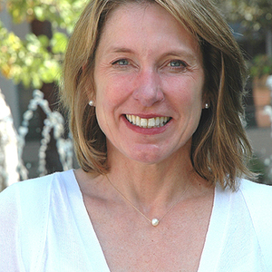
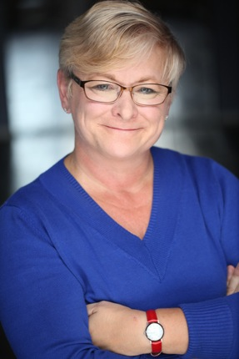

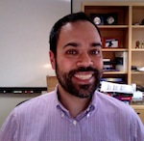
Diane Mackie
Wendy Wood
Linda Skitka
Sanjay Srivastava
Eli Finkel

Slide 3
Climate Survey Results

Slide 4
Overview
Survey launched September 22, 2016
730 people responded
450 people use social media for scientific reasons

Slide 5
Notes:
About half are totally overlapping between the two groups.

Slide 7
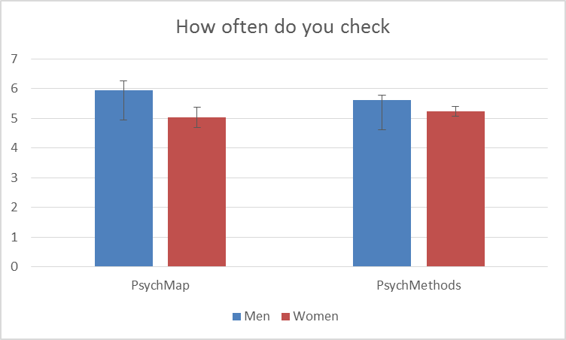
7 = more than once a day
*
*
0 = never
No significant differences by career stage, or racial (majority/minority) status
Notes:
Average is about 5.6, so once a day for both groups

Slide 8
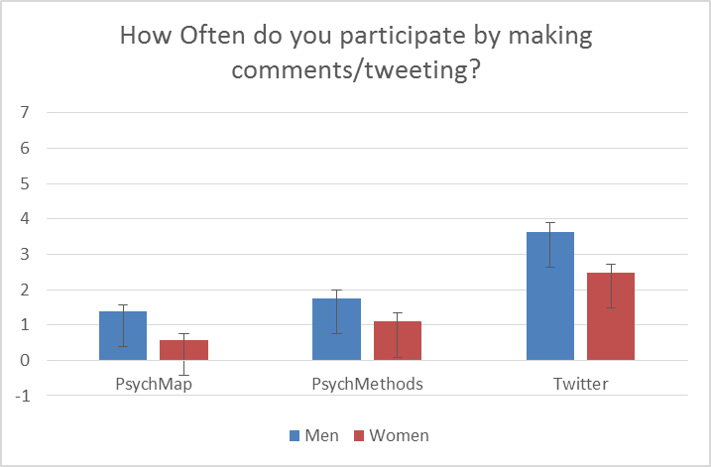
7 = more than once a day
*
*
*
*
*
0 = never
No significant differences by career stage, or racial (majority/minority) status
Notes:
Average is less than once a month. So a lot of lurking, not a lot of posting.

Slide 9
Notes:
Please click all of the following boxes that apply to how you use Twitter to read about or interact with others about social and personality psychology

Slide 10
Why we DO Post
Percentage of people who checked this item

Slide 11
Why we DON’T Post
Percentage of total N who checked this item

Slide 12
Do people think social media is helpful or hurtful to their careers?
Notes:
For the majority of the findings for variables related to career progress, there are gender differences. There are no race differences, and there are a few career status differences, within early career people (pre grad school) thinking its more useful for career progress than everyone else.

Slide 13
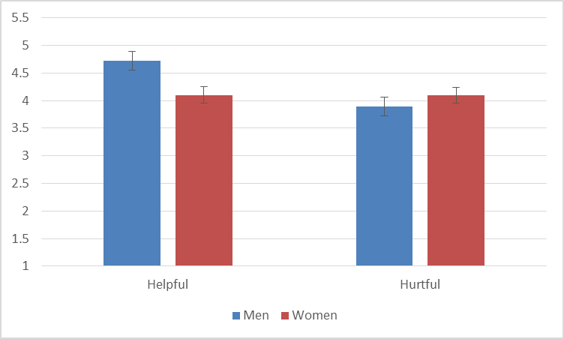
To what extent do you think engaging in conversations on social media platforms is helpful/hurtful for your OWN career
*
1 = not at all
to
7 = very much

Slide 14
To what extent do you think engaging in conversations on social media platforms is HELPFUL for women and men
*
1 = not at all
to
7 = vsery much
Notes:
Men think it is more helpful than women do (for women), but men and women agree on how helpful it is for men, and that it is more helpful for men than women

Slide 15
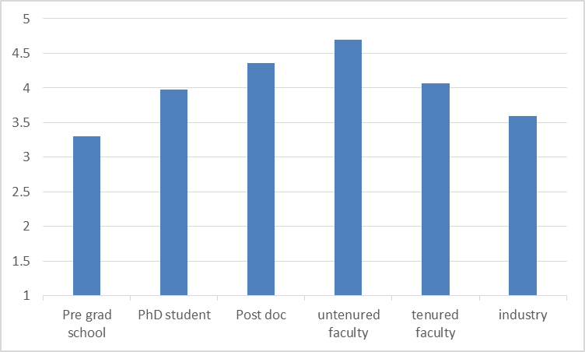
To what extent do you think engaging in conversations on social media platforms is HURTFUL for your own career
1 = not at all
to
7 = very much
Notes:
Untentured faculty think it is significantly more hurtful than anyone else

Slide 16
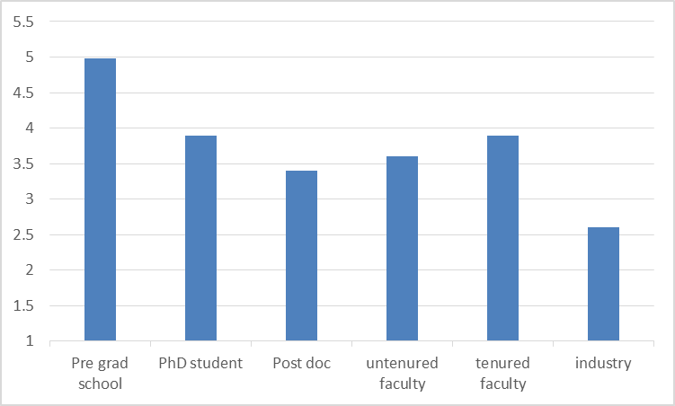
To what extent do you think engaging in conversations on social media platforms is HELPFUL for junior scholars
1 = not at all
to
7 = very much
Notes:
Pre graduate school think it is significantly more helpful than anyone else

Slide 17
Social media is an important place for scientific conversations to take place
*

Slide 18
“I just don’t have time for this sh*t!”
Anonymous female participant
Notes:
Why do we see gender differences in engagement, ,well perhaps it’s the case as woman female participant put it

Slide 19
The type of feedback we receive
Notes:
Maybe women feel like they are getting bullied more on social media?
Turns out not to be the case. Men and women feel equally like they are getting positive feedback. Men feel more attacked (perhaps beause thtey are more involved)

Slide 21
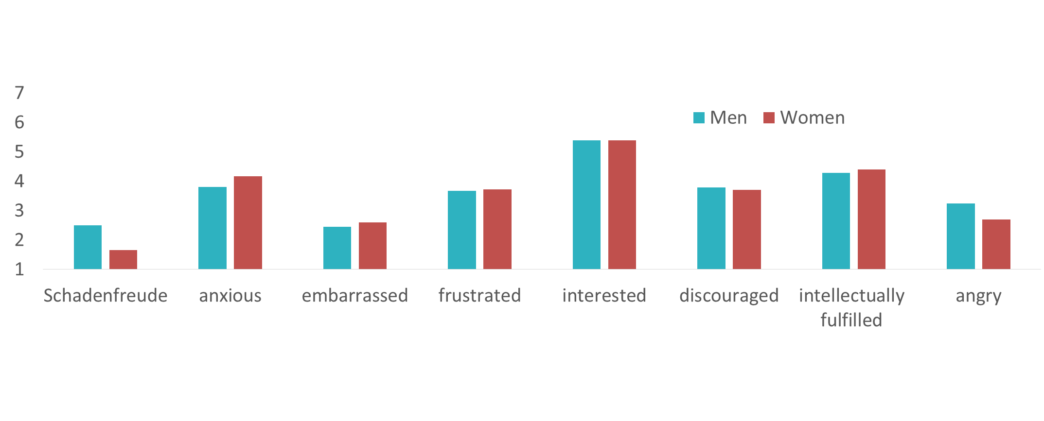
The emotions we feel….
Notes:
Only one gender difference: men feel more schedenfreude

Slide 22
Final Result for Thought
Although feeling personally attacked and seeing others being attacked both significantly predict feeling disengaged from the field, the effect size for seeing others attacked is twice the size

Slide 23
Now it’s time to hear from the panel!

