Slide 1
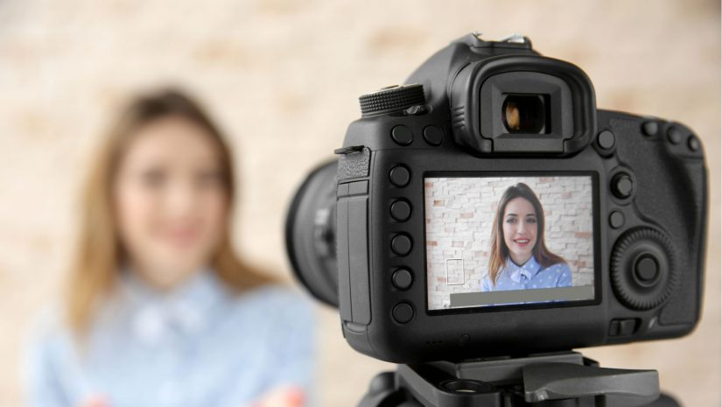
Turn on Your Video Cameras!
Capturing Behaviors alongside Physiology to Understand Dyadic and Group Interactions
Katherine R. Thorson
Tessa V. West

Slide 2
Turn on Your Video Cameras!
Capturing Behaviors alongside Physiology to Understand Dyadic and Group Interactions
Katherine R. Thorson
Tessa V. West
Notes:
Thanks very much to Katherine and Emily for inviting me today – this is absolutely a session that I would be attending even if I weren’t presenting so I think this is a great idea.

Slide 3
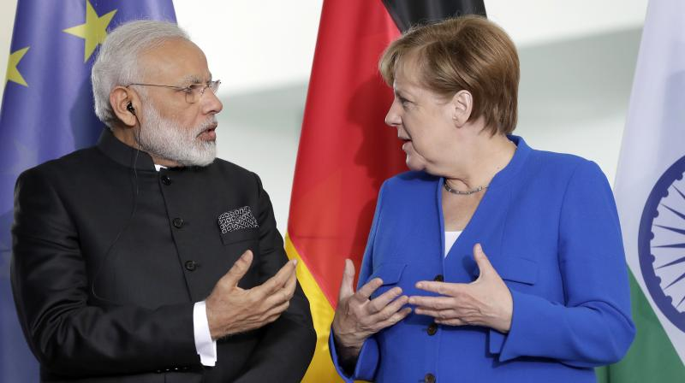
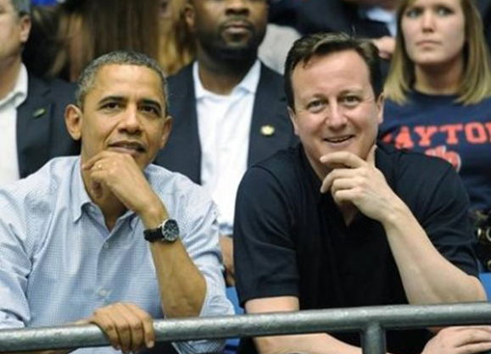
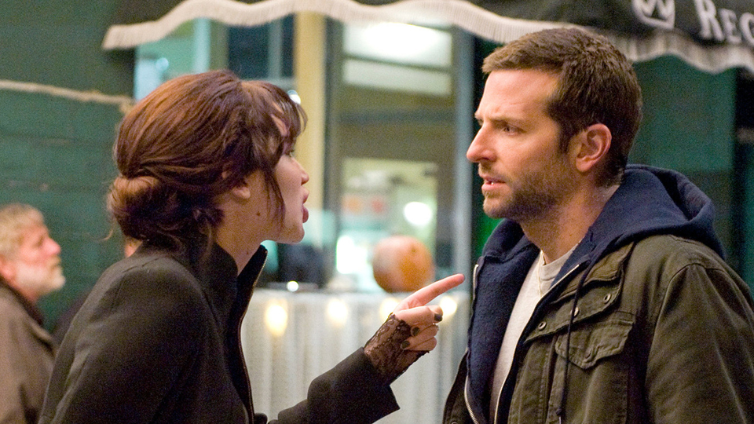
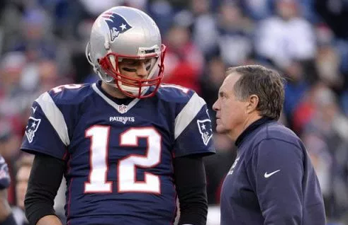
Notes:
We are all at this symposium because we really want to understand the “social” part of “social psychology” meaning what happens when we interact with other people.
One way that researchers have been trying to understand social interactions is by looking at physiological responses of people over time while they are interacting with each other.

Slide 4
Physiological Correspondence
Therapists and patients (Coleman, Greenblatt, & Soloman, 1956; DiMascio, Boyd, & Greenblatt, 1957; Marci, Ham, Moran, & Orr, 2007)
Spouses (Chatel-Goldman, Congedo, Jutten, & Schwartz, 2014; Levenson & Gottman, 1983; Reed, Barnard, & Butler, 2015)
Children and parents (Bernard, Kashy, Levendosky, Bogat, & Lonstein, 2017; Hill-Soderlund et al., 2008; Suveg, Shaffer, & Davis, 2016)
Teammates (Järvelä, Kivikangas, Kätsyri, & Ravaja, 2013; Mitkidis, McGraw, Roepstorff, & Wallot, 2015)
Reviews: Timmons, Margolin, & Saxbe, 2015; Palumbo et al., 2016
Notes:
Research since the 1950s has been showing that people can exhibit correspondence or similarity in their physiological responses with others while they are interacting.
What I want to talk about today is how we can go beyond documenting that physiological correspondence exists to understanding more about what it indicates psychologically
And I’m going to start by presenting you with a problem.

Slide 5
Physiological Linkage
Notes:
Let’s imagine we have two people interacting and we are measuring their physiological responses over time. Here we are looking at heart rate as a basic example. And we find some kind of physiological similarity between them.
Let’s imagine the physiological response of the first person is predicting the physiological response of the second person at a later time point. For the purposes of my talk today I’m going to call this “physiological linkage”

Slide 6
HR = 65
HR = 68
HR = 72
HR = 77
Notes:
So something like this….the first person predicts the second person at a later time point
This by itself does not provide us with a ton of information about what’s going on between the two people.

Slide 7
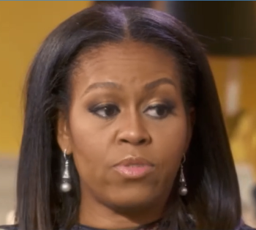
HR = 65
HR = 68
HR = 72
HR = 77
Notes:
For example, maybe you think that one person in the dyad is feeling threatened and she is passing that psychological experience of threat to her partner, which causes her partner’s physiological responses to mimic hers.

Slide 8
HR = 65
HR = 68
HR = 72
HR = 77
Notes:
Or maybe you think that one member of the dyad is particularly motivated to pay attention to her partner and through this close attention, she picks up on her partner’s psychological experience and her physiological response then ends up mimicking that of her partner’s
These are different psychological inferences from the same physiological data – and these are common psychological inferences that people make from this type of data pattern.

Slide 9
HR = 65
HR = 68
HR = 72
HR = 77
Notes:
The point of this example is to say it’s hard to know what’s going on psychologically here with just the physiological data. Just as with any physiological response, there’s not a one-to-one relationship with a particular psychological experience.
So now I want you to imagine if what we’ve done as researchers is alongside studying our participants’ physiology, we’ve also captured video recordings during the interaction as well.

Slide 10
Notes:
So now we have captured data like this.
We could use that video data to figure out what people are saying to each other, how much they’re making eye contact with one another, what their hand gestures are, their facial expressions, their body posture, etc.
And we can examine these behaviors alongside physiology to have a much more powerful set of tools for understanding what’s going on in the interaction.

Slide 11
Overview
Theory
Methods
Analysis
Notes:
Today I’m going to discuss a little bit about why – theoretically – we think behavior should help us in understanding the psychology associated with physiological linkage.
I’ll talk briefly about some methodological concerns with capturing behavior and physiology together
And then finally I’m going to give a couple of tips for analyzing this type of data.

Slide 12
Notes:
Before I go any further, I want to point out that, in collaboration with Tessa West and Wendy Mendes, I have a paper that was just published in Psych Methods that provides a lot more information on all of the components I’m going to discuss today so I recommend checking that out if you’d like further information.

Slide 13
Overview
Theory
Methods
Analysis
Notes:
Ok, let’s start with theory.

Slide 14
Physiological Linkage
The physiological state or process in one person needs to result in information that can be “picked up” by the partner.
Notes:
We’ve proposed that for linkage to occur….
In other words…if physiological linkage is to indicate something about the psychology of a social interaction, there must be some kind of social cue between people to result in that linkage.
And we base a lot of our ideas here on Brunswik’s lens model and on Funder’s Realistic Accuracy Model

Slide 15
Hand fidgeting
Michelle’s physiological response
Oprah’s physiological response
Biting
lip
Avoiding eye contact
Notes:
Let’s say Michelle Obama felt threatened during her interview with Oprah – maybe she’s being asked to reveal more than she really wants to on national television
So she feels threatened and she shows a physiological pattern of threat and then she shows these threat behaviors
Oprah could notice these cues and then subsequently she may also feel threatened and show that physiologically

Slide 16
Smiling
Michelle’s physiological response
Oprah’s physiological response
Nodding her head
Making eye contact
Notes:
What if instead physiological linkage is still occurring but now Michelle is smiling, nodding her head, and making eye contact with Oprah
That likely tells us that physiological linkage is reflecting a very different pattern psychologically
So theoretically this is why looking at behaviors should help us understand linkage.

Slide 17
Shared Environments
Notes:
I want to be clear here - I am not talking about what happens when people’s physiological systems become similar because they are exposed to the same stimulus. So, for example, watching the same movie Those questions are interesting in their own right, but that’s not what I’m talking about today.
Instead, I’m talking about what happens when two people are interacting with one another and a social process between them causes correspondence in their physiological states. That’s where these behaviors or other cues between people should cause linkage and studying them together can really help us figure out what’s going on in social interactions

Slide 18
Overview
Theory
Methods
Analysis
Notes:
So that’s part of the theoretical background of why looking at behavior can be so informative here.
I want to talk now about a couple of key methodological concerns here.

Slide 19
Behaviors of Interest
What are the questions you’re trying to answer?
What predictions would theory make regarding the social interactions you’re studying?
Notes:
One is that you need to select behaviors of interest to examine. We all know that our video files don’t magically show up in our data files with lots of relevant behaviors coded.
We have to choose those! And my suggestion is that people start with theory. What are the questions you’re trying to answer? What predictions would theory make regarding the social interactions you’re studying?
This is not a one size fits all where certain behaviors are the ones you’ll always want to study.
To show this, I’m going to use an example from my research

Slide 20
Study Overview
Women highly identified with math
Prior to working together, women completed either a threat or a control manipulation
Notes:
We were interested in studying women who were highly identified with math. And we wanted to know what happened when they were threatened before working with a partner on a math task.
So prior to working together, all of the women in our study completed either a threat or a control manipulation. And this threat manipulation was specifically related to their performance in math.

Slide 21
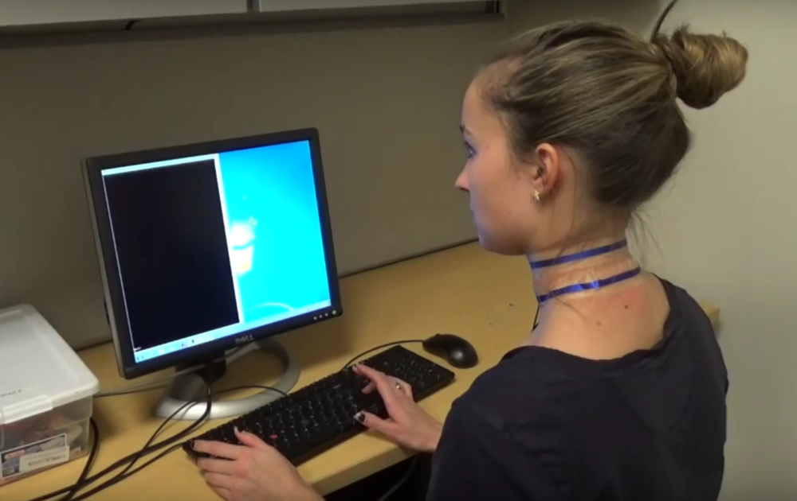
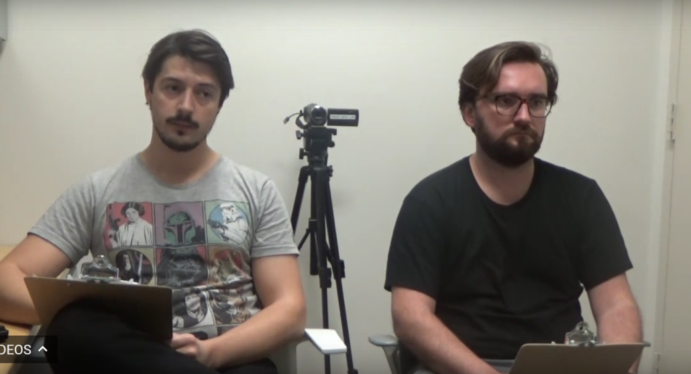
Threat and Control
Everyone: count backwards from 2023 in increments of 17
Threat: in front of two stoic evaluators
Control: on the computer

Slide 22
Threat vs. Control
Pilot study: N = 77
Cohen’s d = 0.91
t(75) = -3.92, p < .001
Notes:
We knew from pilot testing that our threat manipulation led to increased perceptions of threat regarding math but we wanted to know how that affected women when they worked with a partner afterward

Slide 23
Threat manipulation
THREAT
Dyadic math task
PARTNER
Control manipulation
:
Control manipulation
CONTROL
Dyadic math task
Control manipulation
CONTROL
:
:
Notes:
We paired women who did the threat manipulation with those who did a control manipulation. They did the math task together.
I’m going to refer to these two conditions as “threat” and “partner”
We also had control dyads for comparison purposes where both partners did a control manipulation. I’ll refer to this condition as “control”

Slide 24
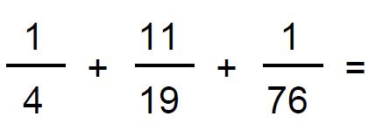
Study Overview
Solved math problems together
30 x 13
N = 104; 52 dyads
Notes:
Once participants were paired up, they solved math problems together and we measured their sympathetic nervous system activity via cardiac pre-ejection period

Slide 25
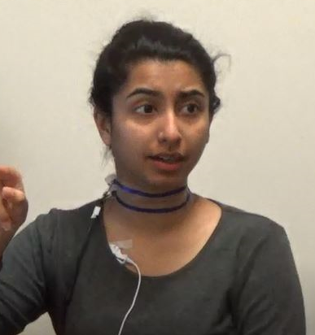
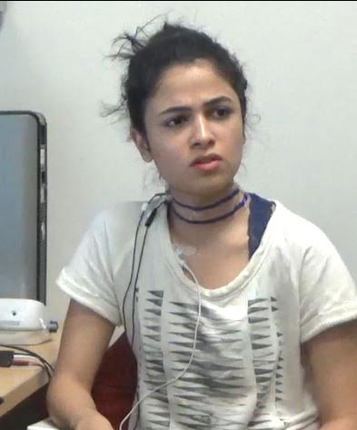
THREAT
PARTNER
Notes:
We were interested in testing for two patterns.
First, we theorized that we might see threat contagion. So women who had been threatened might “pass” their psychological experiences of threat on to their partners.
So perhaps the threatened woman on the left might predict her partner’s responses in a process where she is gives off threat cues that cause her partner to feel threatened

Slide 26
Behaviors of Interest
Threat behaviors
Fidgeting with hands
Biting lip
Threat statements
“This is stressing me out”
“I just can’t do this”
Notes:
If this was the case, we figured we would see that women under threat would engage in certain behaviors that would pass their threat on to their partners.
To figure out if this was the case, we coded threat behaviors – like fidgeting with hands, biting one’s lip
We also coded threat statements that participants made while working together – like “this is stressing me out” and “I just can’t do this”
So those are behaviors we coded based on a hypothesis that threat contagion would occur

Slide 27
THREAT
PARTNER
Notes:
A different hypothesis that we had was that women who had been threatened would be extra motivated to do well on the math task because they were people who really cared about math and had just been threatened in that domain.
So we thought they might pay extra close attention to their partners who could help them, and by attending to them so closely, they would mimic their physiological patterns over time.
So in this case we thought the control partner’s responses would predict the threat partner’s responses because the women under threat are attending so closely to their partners and picking up on their general affective intensity

Slide 28
Behaviors of Interest
Helpful behavior: Talking about the math problems
“You can tell that it would be a 6 at the end
and then 2 times 5.”
“I think it’s #1… the first digit was 6, the second digit was 9 ‘cause you would have had the 1 carried over from the 8 so 9 plus 0.”
“It was #2…because 16 times 3 is 48, right?”
Notes:
To understand whether this might be the case, we coded the amount of time that all of the participants spent talking about the math problems…how much they were working through or explaining the problems out loud.
Because we thought ok, if you’re someone very motivated to do well here, you would want to pay close attention when you have a partner who is giving you helpful information.
So now with these behaviors coded, we could start to examine our physiological and behavioral data in tandem to figure out the underlying psychological experiences of these dyad members

Slide 29
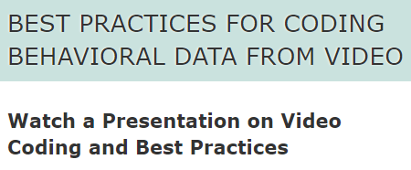
Notes:
Very quickly, I want to say that there are lots of other concerns you might have regarding how to collect behavioral data from video, and I want to point you to open software for coding behavioral data from video called Datavyu. Check it out online – they have lots of webinars about collecting video data and how to code it and their software is super useful.

Slide 30
Overview
Theory
Methods
Analysis
Notes:
Now let’s imagine you’ve collected your perfect behavioral data based on theory and now you need to analyze it.

Slide 31
More info: osf.io/6qvtu/
katherinethorson.com
Notes:
The data I’m using and my analyses and some webinars describing this approach are on the OSF framework and my website so if this is an approach you’re considering using or want to know more about, please check them out.

Slide 32
Average Behavior Over Time
Notes:
My first suggestion with your data when you first sit down with them is to look at mean levels over time.
This is before you dive into any analyses of physiological linkage or any kind of similarity
Just graph out mean levels of behaviors
For example, in this study, we found that there were low levels of threat behavior among everyone
Scale of 1 to 7

Slide 33
Average Behavior Over Time
Notes:
We also found that there were very low levels of threat statements.
Each time point here represents about 3 minutes so, on average, there’s not even 1 statement for every 3 minutes.
So not a lot of behavioral threat here

Slide 34
Average Physiological Reactivity
*Lower numbers mean greater reactivity
Notes:
I also encourage you to just graph out physiological reactivity over time.
In this study, we used pre-ejection period as the physiological response we were interested in – so this is a measure of sympathetic nervous system activity.
-15 might be giving a speech in front of evaluators
-8 talking with a new partner you haven’t met before
And 0 of course is no reactivity
So there’s certainly a good amount of reactivity at the beginning but it declines and levels off over time – not something that we would probably see if threat were sort of being continually passed between the two partners.

Slide 35
THREAT
PARTNER
Notes:
So threat contagion was our first hypothesis about what was going on but with these analyses, we’re able to tell that that’s pretty unlikely

Slide 36
Behaviors with Linkage
Person B’s physiology
Time T - K
Person A’s physiology
Time T
Person A’s physiology
Time T - K
Notes:
But we can continue to check that hypothesis by seeing whether threat behaviors are associated with physiological linkage.
Very simply we might think of the model like this where Person A’s physiology is predicted by her partner’s physiology at the prior time point, while adjusting for her own at the prior time point.

Slide 37
Behaviors with Linkage
Person B’s physiology
Time T - K
Person A’s physiology
Time T
Person A’s physiology
Time T - K
Notes:
And we can moderate this linkage path here that shows the effect of one partner’s physiology on the other’s at a future time point with the behaviors that we’ve measured to see whether physiological linkage is associated with those behaviors.

Slide 38
Linkage and Threat Behavior
3-way interaction: F(2, 665) = 0.19, p = .83
Notes:
And when we do this in this data set, we find that linkage is not moderated by the partner’s threat behavior for any of the groups in our study
In other words – people are not more likely to mimic their partner’s physiological responses when those partners are behaving in a threatened way as we would expect if threat contagion were occurring

Slide 39
Linkage and Threat Statements
3-way interaction: F(2, 2390) = 0.16, p = .85
Notes:
Similarly, people are also not more likely to mimic their partner’s physiological responses when those partners are making threatened statements
So this puts the final nail in the “threat contagion” hypothesis because physiological linkage is not associated with behaviors that we might think would make threat contagious.

Slide 40
Linkage and Math Talk Time
3-way interaction: F(2, 1830) = 3.13, p = .044
*p < .05
Notes:
Now recall our second hypothesis- which was that women under threat would be motivated to do well and closely attend to partners who could help them.
And I’ll remind you that we coded for helpful behavior from partners – how much people were talking about the math taks

Slide 41
Linkage and Math Talk Time
3-way interaction: F(2, 1830) = 3.13, p = .044
*p < .05
Notes:
Interestingly, what we find here is that, in the threat condition, people’s physiology is being predicted by their partners (that is, they are physiologically linked to their partners) when those partners are spending more time talking about math.

Slide 42
Linkage and Math Talk Time
3-way interaction: F(2, 1830) = 3.13, p = .044
*p < .05
Notes:
the key point is that the only group who is linked to their partners MORE specifically when those partners were talking about math are the women who were threatened.
Suggesting that instead of passing threat to their partners, in fact, these threatened women were physiologically influenced by their partners and because of when this happened –when those partners were talking about math – it points to us that they were particularly attuned to people who could be helpful to them.

Slide 43
Linkage and Math Talk Time
3-way interaction: F(2, 1830) = 3.13, p = .044
*p < .05
Notes:
In the control condition and for the partners, we don’t see this pattern.
This is very interesting. What this shows is NOT that the women under threat are predicting their partner’s physiological responses but VICE VERSA. Very opposite of this threat contagion hypothesis. And because of WHENthat happened – it happened when their partners were talking a lot about math – we can draw the conclusion that they are particularly attuned to people who could help them on this task.
So I hope you can see how these behaviors in combination with studying physiological linkage can reveal a lot about what people are experiencing and what they’re doing when interacting with others.
Really importnatly, we could not have had such rich information about participants’ experiences in this study if we did not measure physiology and behavior in TANDEM

Slide 44
What else can you use?
Performance on a joint task
Context: experimental manipulation, task
Participant population
Subjective experiences
Notes:
OK, so today I talked all about how you could use behaviors that are captured via video cameras alongside physiological linkage to help you understand when and why people exhibit physiological similarity and what this might mean psychologically.
I want to point out that there are also other kinds of information you could use here:
For example, performance on a joint task, ,the context (what did you manipulated, what is the task)?
Who are your participants? What can you theoretically expect from them in this context?
And then finally participants’ subjective experiences.
All of these could be used in a very similar manner to behavior to help figure out what’s going on

Slide 45
More info: osf.io/6qvtu/
Interval length for behaviors and physiology
Video coding process and ensuring reliability
Equations for physiological linkage model and model with moderation by behavior
Description of all fixed and random effects in physiological linkage model
Annotated syntax with data
Notes:
There are lots of things I didn’t have time to discuss today so please check out the resources I’ve put on the OSF. These slides are there as well for your future reference

Slide 46
Notes:
I hope to have shown you that capturing behaviors via video alongside physiology measured in two people simultaneously can be a powerful tool for understanding social interactions and
that these methods allow us to study the complexity of social interactions dynamically and in naturalistic contexts to understand how people communicate with and influence each other.

Slide 47
Thank you!
Tessa West
Wendy Berry Mendes
Chad Forbes
More info: osf.io/6qvtu/
Notes:
Thanks to my primary collaborators on this work, thanks to our research team at NYU, thanks to the funders of this work, and thank you for your attention today

