Slide 1
Are Those Who Are Influenced by Their Partners’ Physiological States Also Less Stable?
Tessa West
Katherine Thorson
New York University

Slide 2
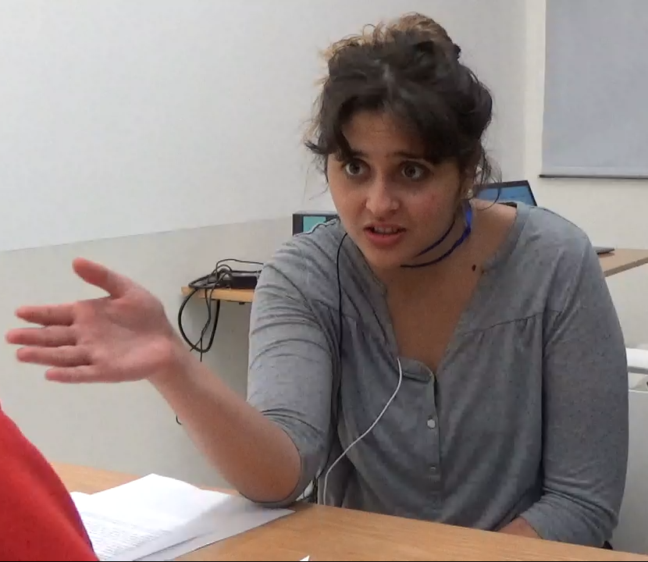
Notes:
Often in interpersonal encounters, people give off all sorts of emotion displays that can be interpreted with different meaning
Here are some examples from a study I just ran in AD, where people engaged a few negotiation tasks. The woman here gave off a series of clear emotion displays
Left Boy: New Zealand
Girl: Chile
Boy in Red: Gambia

Slide 3
Physiological Linkage
A
HR = 77
HR = 78
B
HR = 72
HR = 78
Thorson, West, and Mendes (2018, Psych Methods)
Thorson & West (2018, Bio Psych)
Notes:
We can look at the extent to which one person’s physiology at one time point predicts another group member’s physiology at a later time point.
You can see here – if person a predicts person b’s physiology – then person B is said to be physiologically linked to person A

Slide 4
Physiological Linkage
A
HR = 78
HR = 85
B
HR = 67
HR = 72
Thorson, West, and Mendes (2018, Psych Methods)
Thorson & West (2018, Bio Psych)
Notes:
Within the same model, I can also flip this so that now Person B’s physiology predicts A’s over time

Slide 5
STABILITY
Larry’s physiology
Time T-1
Larry’s physiology
Time T
INFLUENCE
INFLUENCE
Michelle’s physiology
Time T-1
Michelle’s physiology
Time T
STABILITY
Notes:
In this model, we also adjust for physiological stability – the extent to which people predict their own physiology over time
Likely biggest predictor
We are adjusting for this
Linkage or influence over and above physiological stability
Anyone familiar with dyadic analyses will notice that this is a modified version of the Actor Partner Interdependence Model that can be used for repeated measures within dyads

Slide 6
Does being influenced by one’s partner lead people to be less physiological stable?
Notes:
In a team context, is part of the hijacking of stability for the sake of influence lead to better group outcomes, and group processes (people coming to a consensus)
What does this mean for people who are temperamentally stable or unstable, influence may be able to move stability around? What if it means if am influenced by others, does this sacrifice my stability?

Slide 7
For whom are physiological stability and linkage negatively associated?
Compare the stability-influence relationship between high status and low status people in dyadic and group interactions
Notes:
Get into the idea that there might be more a cost to stability for some people compared to others
Note that in all of these interactions there are fluxes and flows in the intensity of affective states

Slide 8
3 Studies
Study 1
Cross-race (White-Black) and same-race (White-White) dyadic interactions
Study 2
Cross-status (High HDI- Low HDI) and same-status (High-high; Low-low) dyadic interactions
Study 3
Randomly assigned status in groups of 4 (one High status, 2 or 3 Lower status)

Slide 9
Study 1
Consent,
Hookup,
Baseline
Cortisol T1
Cortisol T2
Person 1
3 Social
Interaction
Tasks
90 min
Consent,
Hookup,
Baseline
Cortisol T1
Cortisol T2
Person 2
West et al., 2017 Psych Science
N = 123 Dyadic Interactions

Slide 10
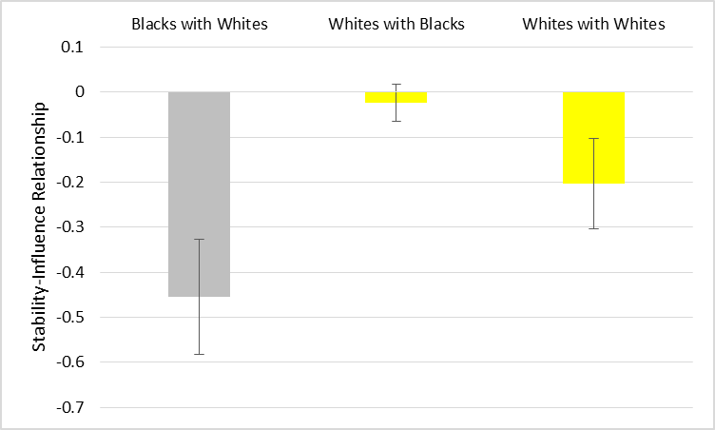
Notes:
What this means for blacks is, the more stable they are, the less they are influenced by their partners, and the more they are influenced by their partners, the less stable they are.

Slide 11
Study 2
N = 117 Dyadic Interactions

Slide 12
Participant Backgrounds
54 home countries
56 languages
13 religions
26 racial groups
No majority group
Notes:
At this university, students are from all over the world.
By studying social interactions there, we can test whether nationality-based status differences shape interactions across a wide range of countries. We know our effects aren’t limited to a few specific countries
Second, by doing this we are able to tease apart country status from majority group status. For example, if we ran this in the United States, the majority of our participants would be American and therefore from a high-status country but also part of the majority group. No one is the majority group there and so we can more carefully pinpoint status differences as contributing to any effects.

Slide 13
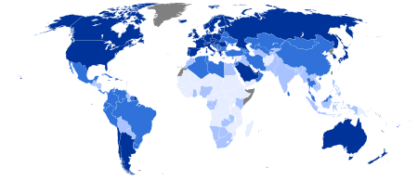
Nationality-Based Status
The amount of admiration and prestige countries receive from people across the world
Human Development Index (HDI)
Composite statistic of life expectancy, education, and per capita income indicators
Notes:
We define status as the amount of admiration and prestige countries receive from people across the world
We operationalize status based on the Human Development Index (HDI)—a composite statistic of life expectancy, education, and per capita income indicators for each country

Slide 14
Higher on HDI
According to the 2015 Human Development Index (HDI), Norway is ranked above the Haq-Sen Line, placing it among the top 25% of countries in the world.
Notes:
As I mentioned earlier, we operationalized status based on the human development index.
We broke participants into two categories – high and low
For example, if we had a participant from Norway, he or she would be told that their home country is in the top 25% of countries in the world according to the HDI. To make this really clear, we developed what we called the “Haq-Sen” line And we told people their country was either above or below this line. So one group of people was above the Haq-Sen line.

Slide 15
Higher on HDI
Lower on HDI
According to the 2015 Human Development Index (HDI), Norway is ranked above the Haq-Sen Line, placing it among the top 25% of countries in the world.
According to the 2015 Human Development Index (HDI), Bulgaria is ranked below the Haq-Sen Line, placing it among the lower-ranked countries in the world.
Notes:
Another group of below was BELOW the Haq-sen line.
This is the information that participants are provided with –both about themselves and their partners.

Slide 16
CROSS-STATUS DYAD
Higher on HDI
Lower on HDI
According to the 2015 Human Development Index (HDI), Norway is ranked above the Haq-Sen Line, placing it among the top 25% of countries in the world.
According to the 2015 Human Development Index (HDI), Bulgaria is ranked below the Haq-Sen Line, placing it among the lower-ranked countries in the world.
Notes:
So if we had someone who was higher on the HDI interacting with someone lower on the HDI, this would be a cross-status interaction
I want to note that it’s not the case that status always fell along racial or ethnic lines. You can see here two participants who were a cross-status dyad but both identified as white.

Slide 17
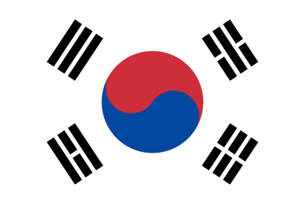
SAME-STATUS DYAD
Higher on HDI
Higher on HDI
According to the 2015 Human Development Index (HDI), Norway is ranked above the Haq-Sen Line, placing it among the top 25% of countries in the world.
According to the 2015 Human Development Index (HDI), South Korea is ranked above the Haq-Sen Line, placing it among the top 25% of countries in the world.
Notes:
Same-status dyads were composed of people from two countries similar in status.
So for example, someone from Norway interacting with someone from South Korea – both two countries high in status according to the HDI.

Slide 18
SAME-STATUS DYAD
Lower on HDI
Lower on HDI
According to the 2015 Human Development Index (HDI), Pakistan is ranked below the Haq-Sen Line, placing it among the lower-ranked countries in the world.
According to the 2015 Human Development Index (HDI), Bulgaria is ranked below the Haq-Sen Line, placing it among the lower-ranked countries in the world.
Notes:
We also had dyads who were same-status because both partners were lower on HDI.
Pakistan and Malawi

Slide 19
Seller
Buyer
Lowest will sell for:
17 million dollars
Highest will buy for:
25 million dollars
Range of acceptable outcomes for both
17 million
25 million
Galinsky & Mussweiler, 2001
Notes:
After participants receive information about each other’s home countries, they have a few minutes to get to know one another before completing the negotiation exercise.
Here’s an example of how one of these exercises unfolded: one person is trying to sell a biotech plant and the other is trying to buy a plant.
the lowest the seller will sell for is 17 million dollars, and the highest the buyer will buy for is 25 million dollars
HOWEVER, they do not have this information about each other. So in negotiating, they are trying to figure out where there partner stands in order to get the best deal for themselves as possible
So during this negotiation we predicted that….

Slide 20
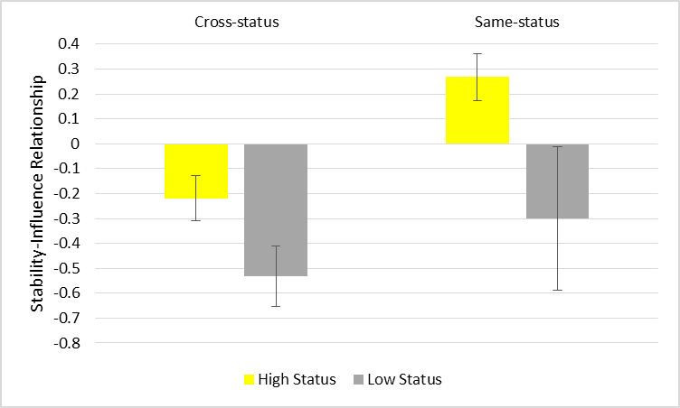

Slide 22
Study 3
Participant 1
Participant 2
Negotiation Task
10 minutes to pick between 5 Firms, goal is to come to a unanimous or majority decision
Participant 3
Random Assignment
Hook-up to HRV Polar Band
Participant 4
N = 31 Groups
(5 3-person, 26 4-person)

Slide 23
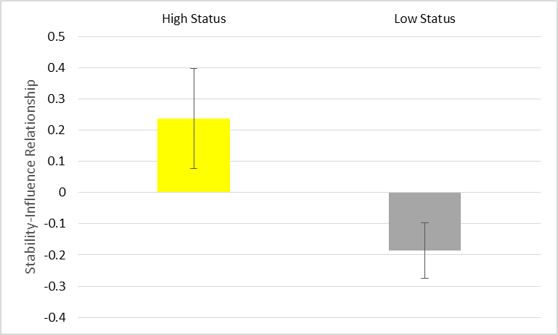
Notes:
;;l

Slide 24
Expansions
Why are stability and influence negatively related?
Actual similarity in within-time point physiological states plays a big role
How does the stability-influence relationship affect other outcomes?
Hijacking stability for influence might be good for group coordination, but bad for individual psychological or health outcomes
Notes:
the relationship between stability and influence is due in part to actual similarity at the prior time point (the more similar they are, the more that stability will "lead to" influence" like assumed similarity leads to accuracy when two people are actually similar. For Blacks, their partner's past scores predict their past scores MORE when they are actually similar (and probably less when they are dissimilar). also, blacks are more stable when they were similar to their partner's in the past. so in other words, actual similarity leads them o be moth more stable and more influenced
IMAGINE THAT TWO PEOPLE HAVE THE EXACT SAME SCORE AT TIME 1—PEOPLE MAY BE MORE STABLE IF THEY ARE SIMILAR TO THEIR PARTNER IN THE PAST (IN THIS SENSE, STABILITY CAN BE THOUGHT OF AS ANOTHER FORM OF INFLUENCE). THEY CAN ALSO (INDEPENDENTLY) BE MORE INFLUENCED. AND IF THEY ARE BOTH OF THOSE THINGS, THEN STABILITY AND INFLUENCE ARE BASICALLY THE SAME PATHS BECAUSE THEY ARE BASED ON THE SAME PRIOR SCORE.
**in the analysis looking a unique stability and influence
We see that only for Blacks with Whites, stability and influence are both positively associated with simiarlity within time point—so those who are similar to their partners in the past are more likely to be stable (adjusting for any overlap between stability and influence), and they are also more likely to be influenced. Adjusting for similarity creates a suppressor effect—the effect becomes even more negative.
Random effects:

Slide 25
Thank You
Oana Dumitru
Kate Thorson
Wendy Berry Mendes

